Slide 1

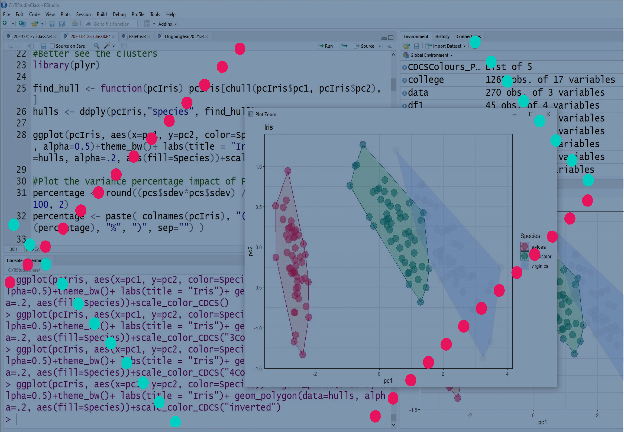
Statistics and Visualisation with R
lucia.michielin@ed.ac.uk

Slide 2

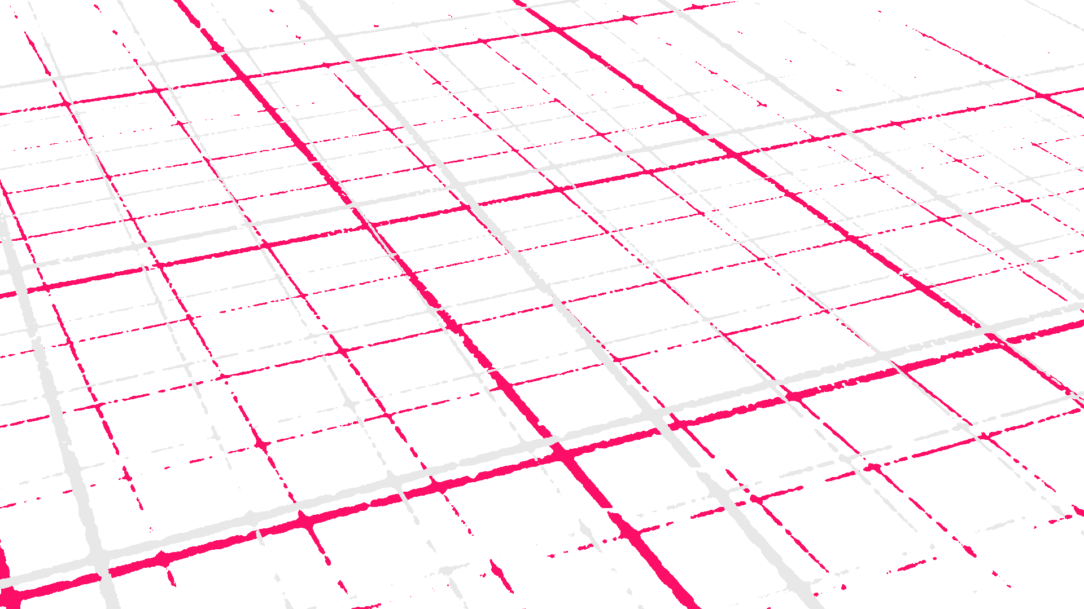

@EdCDCS
For all events, news, and support: cdcs.ed.ac.uk

Slide 3


Feedback and CDCS Training
https://www.cdcs.ed.ac.uk/news/semester-2-training
This series of trainings depend on annually allocated funds!!! To secure them we need to provide detailed feedback on them
FEEDBACK FORM
www.cdcs.ed.ac.uk

Slide 4
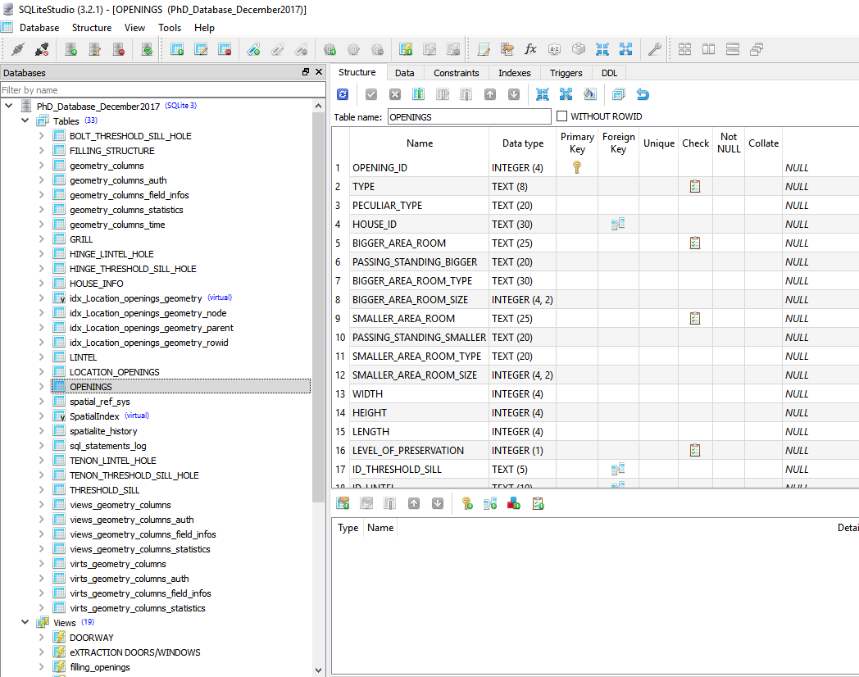
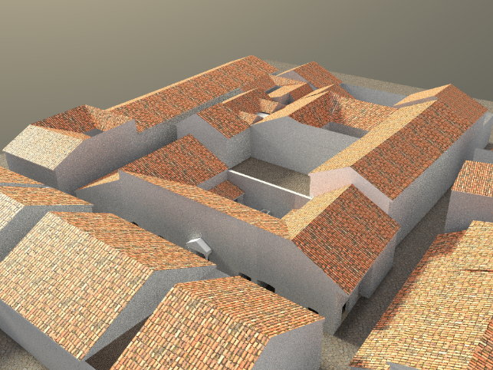
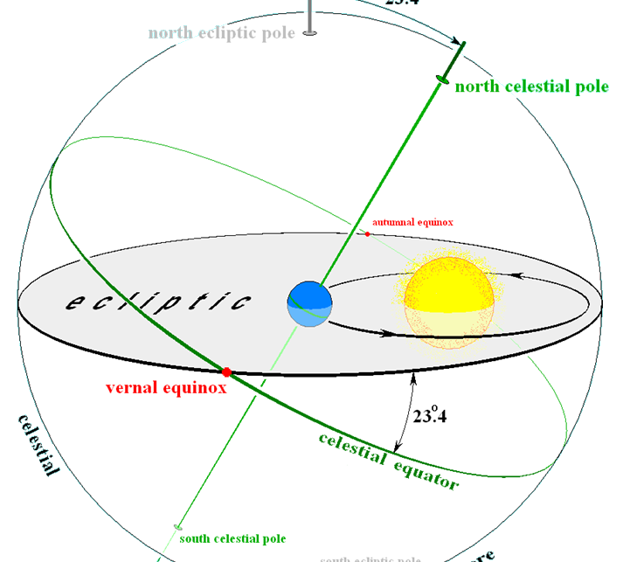

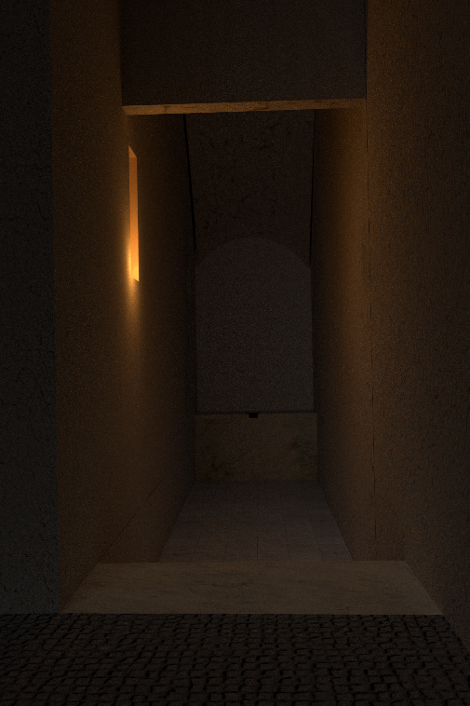
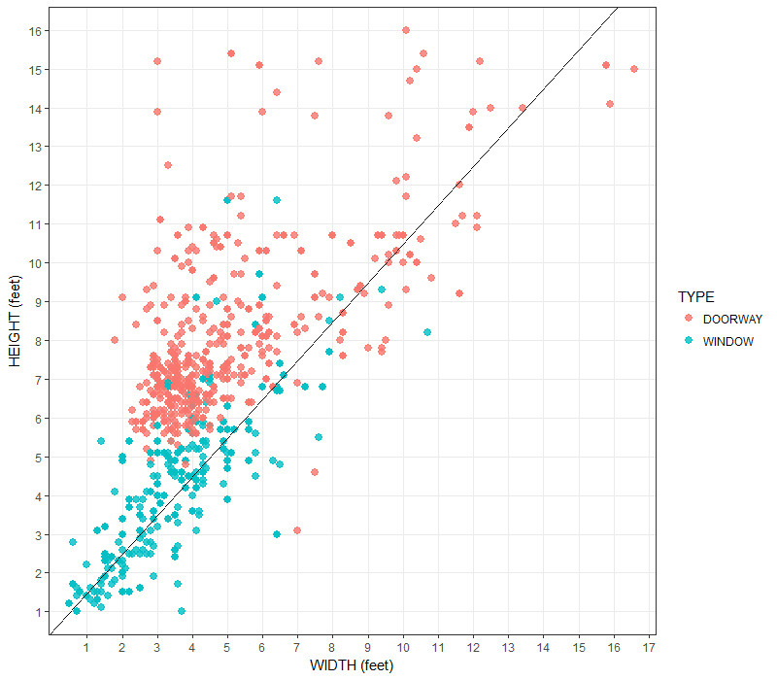
Before starting …
Who am I
I obtained a Phd in Classic from UEd
Training Manager with DCS

Slide 5
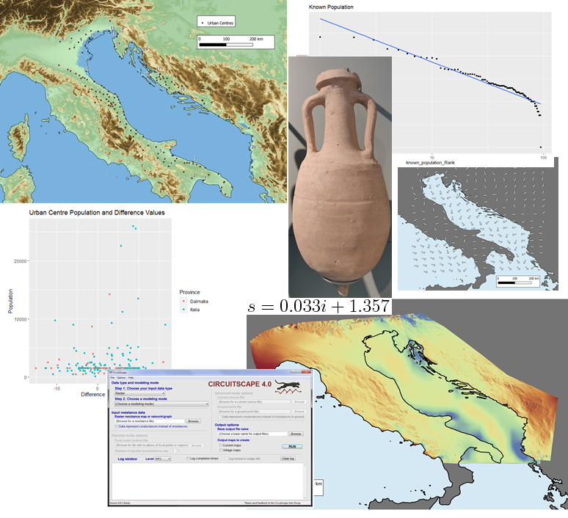
Before starting …
Who am I
PhD candidate in Classics UEd
Training Fellow with DCS

Slide 6
R Statistic and Visualisation:Working Online
Still meant to be interactive
Stop and time for Challenges and Exercises
How to use the material in the Teams channel
www.cdcs.ed.ac.uk

Slide 7

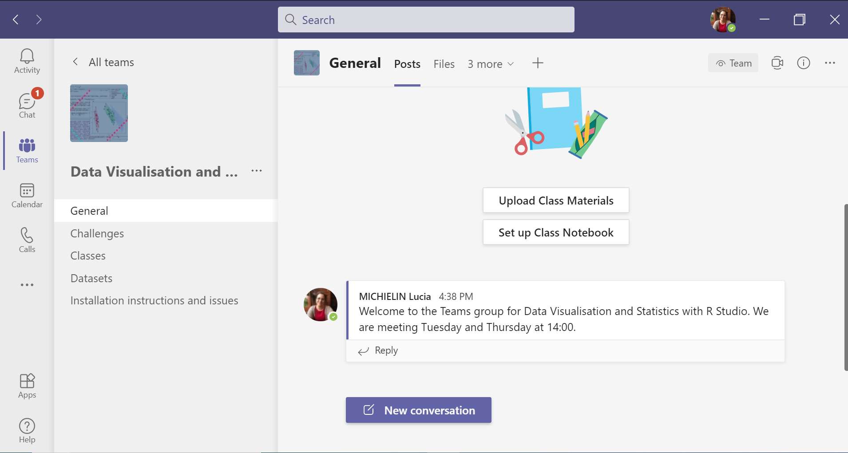
The Teams Team
www.cdcs.ed.ac.uk

Slide 8
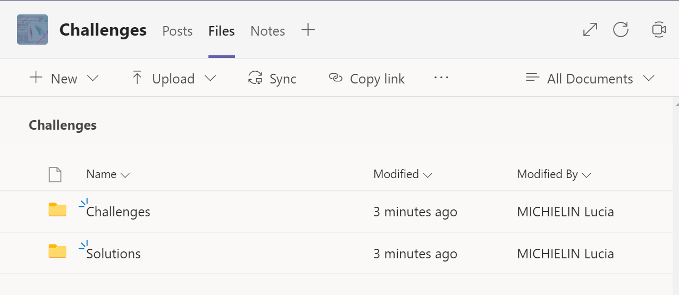
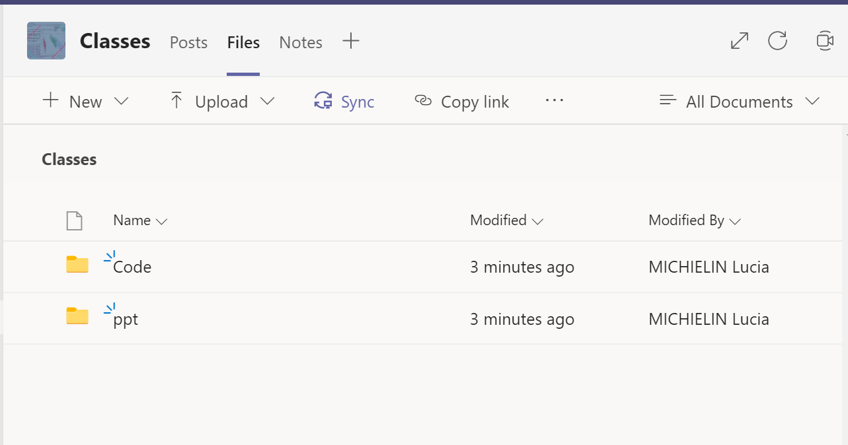
The Files
www.cdcs.ed.ac.uk

Slide 9
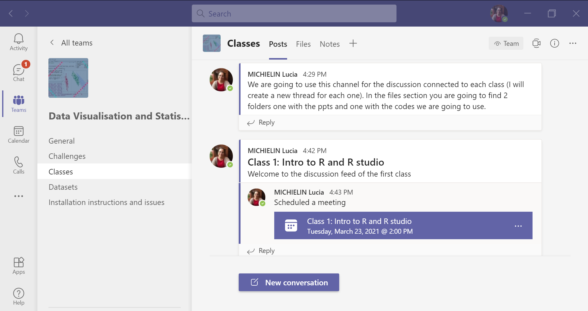
The Teams Chat
www.cdcs.ed.ac.uk

Slide 10
R Statistic and Visualisation:What are we not going to cover
This is not a course to learn programming with R
Very limited Data Wrangling
Much more you can do with R: see the Readme file
www.cdcs.ed.ac.uk

Slide 11
The structure of the sessions
Class 1 23 March 14:00-15:30: Intro to R and R studio
Class 2 25 March 14:00-15:30: Types of data and Grammar of graphs
Class 3 30 March 14:00-15:30: Intro to statistics and descriptive stats
Class 4 01 April 14:00-15:30: Boxplot and playing with colours
Class 5 06 April 14:00-15:30: Data collection bias, probability, and distribution
Class 6 08 April 14:00-15:30: Hypothesis testings and the main tests
Class 7 13 April 14:00-15:30: Barcharts and cleaning the sample
Class 8 15 April 14:00-15:30: PCA and Cluster analysis
Class 9 20 April 14:00-15:30: Covariance, Regression, Similarity and Difference coefficients
Class 10 22 April 14:00-15:30:0: Recap and Bring your dataset class
www.cdcs.ed.ac.uk

Slide 12
Program of Today
Intro to quantitative methods in Research
The R and R studio interface
How to organise your work in R efficiently
How to install packages
www.cdcs.ed.ac.uk

Slide 13
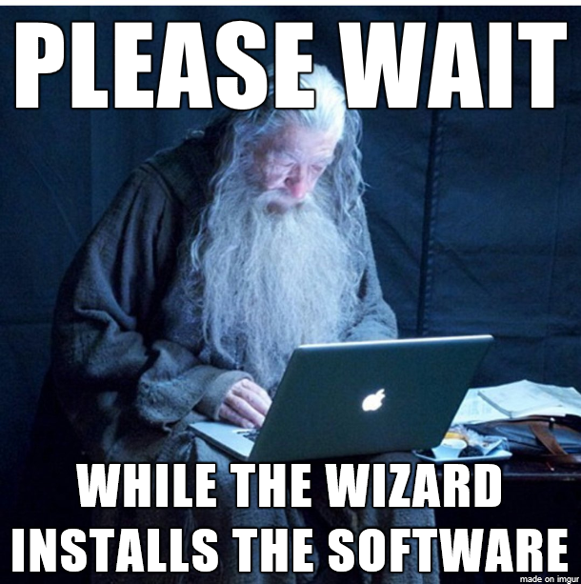
Before we Start
Before We dive into what is it and why it can be a really good tool to help you during your research…
Do you all have R and R Studio installed and ready to go?
If not you can use the Task 0 file to quickly catch up while we finish this introduction
Memegenerator.net
www.cdcs.ed.ac.uk

Slide 14

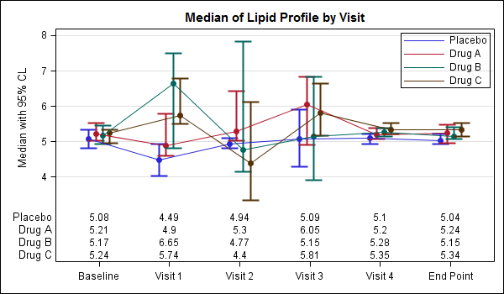

Why using quantitative methods for your research?
Starwars Tie Fighter
From: https://support.sas.com/
www.cdcs.ed.ac.uk

Slide 15


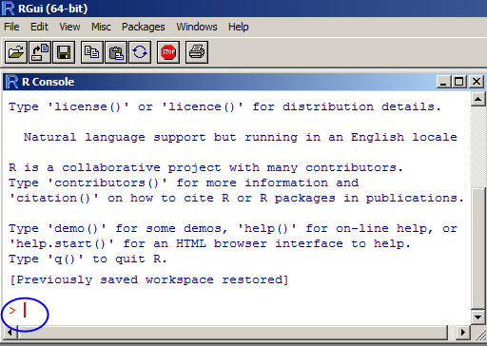
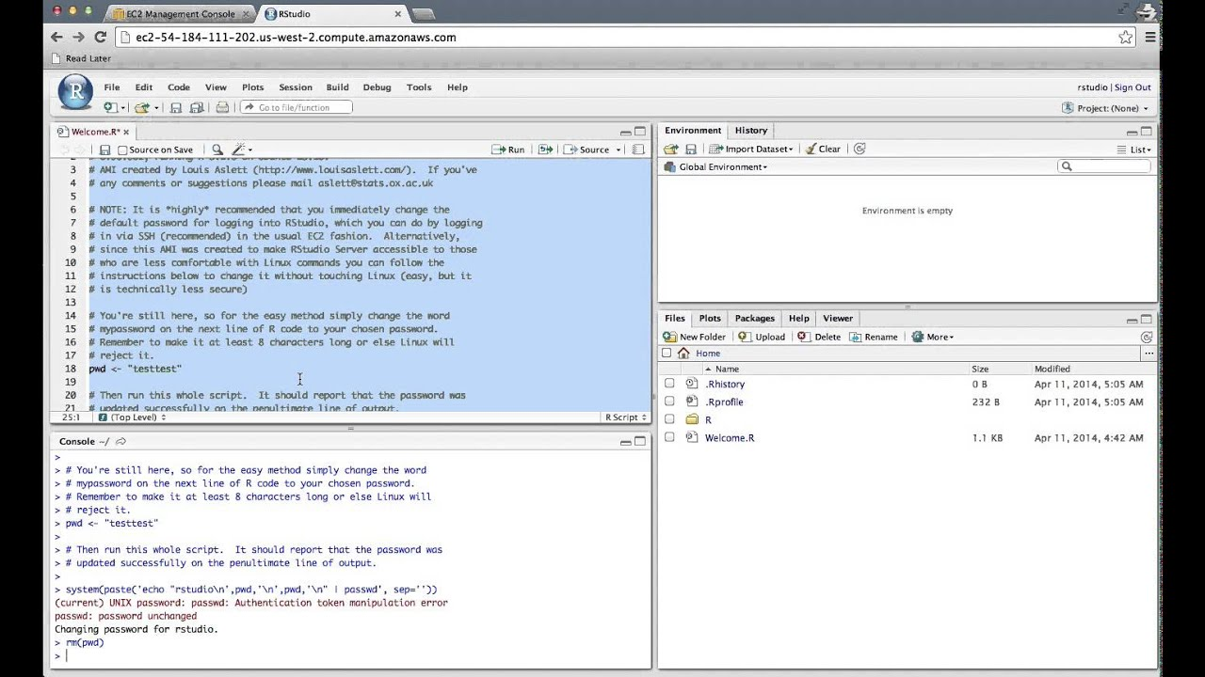
R and R Studio
RStudio is the most popular IDE (Integrated Development Environment) for R.
An IDE is a piece of software that provides tools to make programming easier
R refers to both the Programming Language and the Software that interprets the R scripts
Language
Interface
www.cdcs.ed.ac.uk

Slide 16
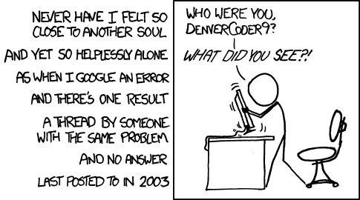
Why Using R
Zero cost (Free but also Open source)
Popular (Is one of the most used languages –more works adds)
Powerful (No if but how, consistently implemented)
Flexible (Package structure)
Support (You are not alone)
https://xkcd.com/979/
https://www.r-bloggers.com/why-use-r-five-reasons/
But I can do a lot of this in Excel without having to code anything …
www.cdcs.ed.ac.uk

Slide 17
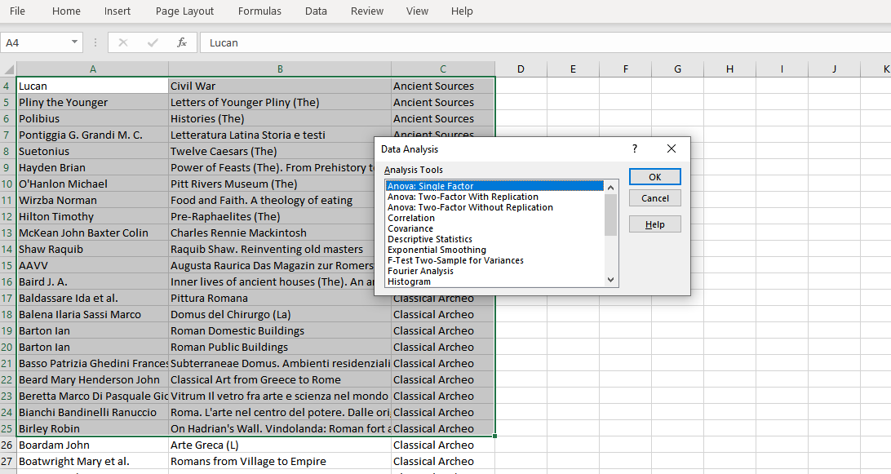
Why not use Excel for Graphs and Basic stats
Impossible to trace back your steps
Need to redo every-step for every analysis (time consuming)
If you need to get back and modify one passage everything needs to be re done
Mostly this is not what is meant to do
www.cdcs.ed.ac.uk

Slide 18
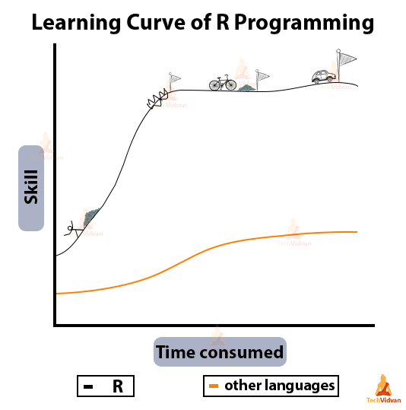
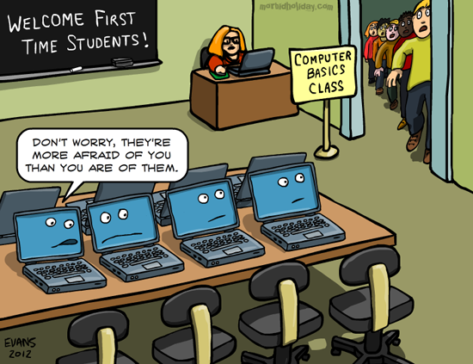
The R Learning Curve
http://creatiwittyblog.com/
www.cdcs.ed.ac.uk

Slide 19
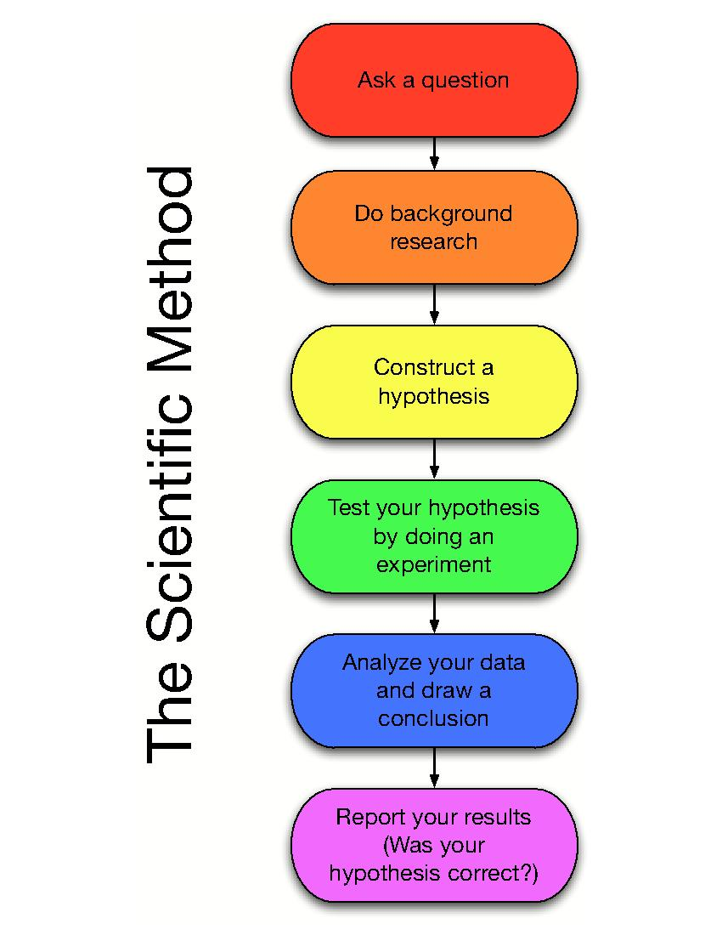
The Scientific Method Process
Research Question
R
R
R
www.cdcs.ed.ac.uk

Slide 20
The Scientific Process
Define a research question
Explore the evidence
Define working hypotheses
Translate hypotheses → statistical models
Compare models to evidence
Interpret results
www.cdcs.ed.ac.uk

Slide 21
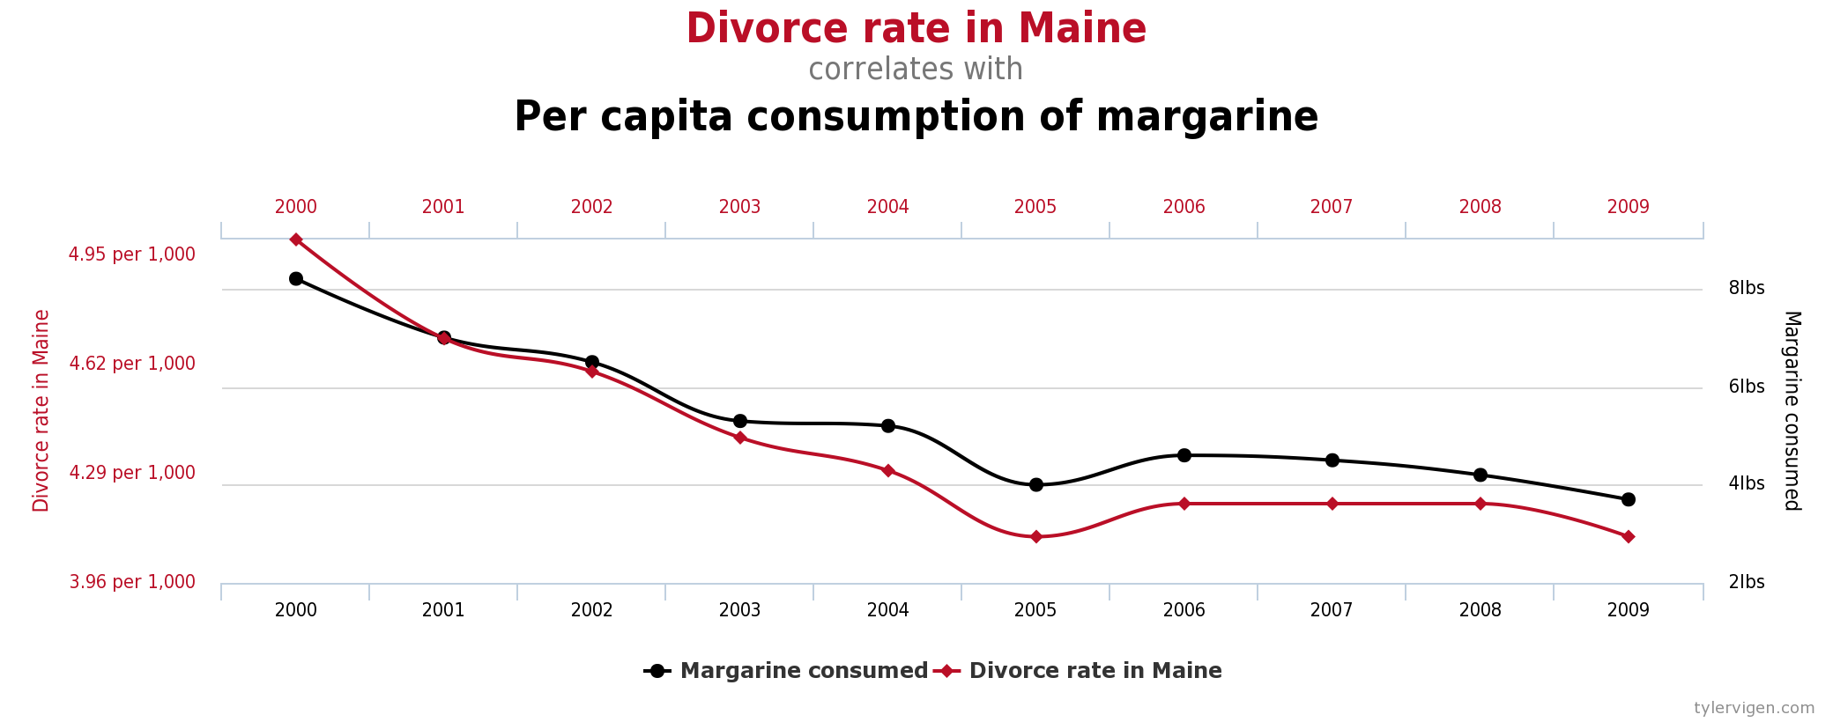
Correlation is not Causation
https://www.tylervigen.com/spurious-correlations
www.cdcs.ed.ac.uk

Slide 22

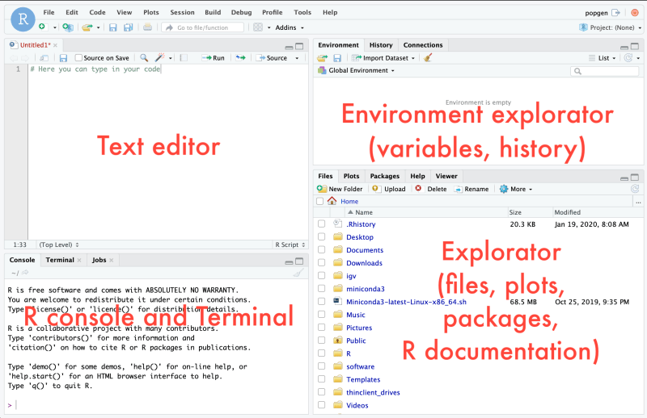
R Studio Interface
www.cdcs.ed.ac.uk

Slide 23
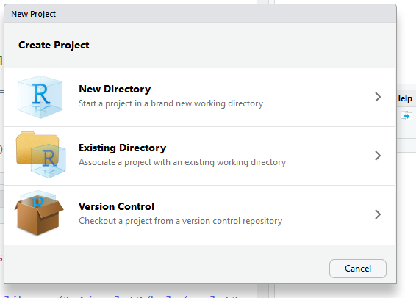
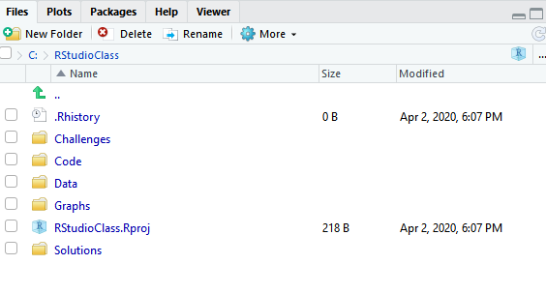
Organise your workspace in R studio
R project, Git and Rhistory
www.cdcs.ed.ac.uk

Slide 24
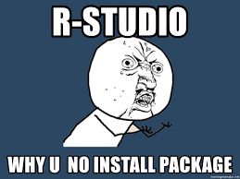
How to install Packages
See current packages
library()#List the available ones
search()#List the ready to go ones
Install packages
install.packages("ggplot2")
Activate packages
library(ggplot2)
Check for updates
update.packages()
To unload packages
detach ("package:ggplot2", unload = TRUE)
To Remove packages
remove.packages("nameofthepackage")
www.cdcs.ed.ac.uk

Slide 25
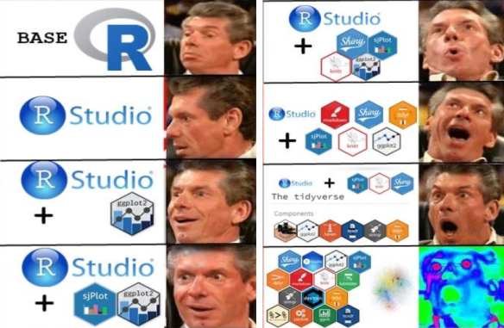

Tidyverse
Series of packages for managing data in R
https://www.tidyverse.org/
www.cdcs.ed.ac.uk

Slide 26

Any Question?
www.cdcs.ed.ac.uk

Slide 27
References
The interface and R Projects
http://ncss-tech.github.io/stats_for_soil_survey/chapters/1_introduction/1_introduction.html#4_rstudio:_an_integrated_development_environment_(ide)_for_r
https://www.youtube.com/watch?v=qzOiX0lcuI8
https://www.linkedin.com/learning/r-statistics-essential-training/taking-a-first-look-at-the-interface?u=50251009
https://support.rstudio.com/hc/en-us/articles/200526207-Using-Projects
https://r4ds.had.co.nz/workflow-projects.html#rstudio-projects
https://www.youtube.com/watch?v=hKoSJGWnFFA
https://www.youtube.com/watch?v=pyJMWlDptYw
Packages what they are and how to install them
https://www.tidyverse.org/
https://rstudio.com/products/rpackages/
https://www.linkedin.com/learning/r-statistics-essential-training/installing-and-managing-packages?u=50251009
https://rpubs.com/mohammadshadan/installpackagesinR https://www.youtube.com/watch?v=u1r5XTqrCTQ https://www.youtube.com/watch?v=3RWb5U3X-T8 https://www.computerworld.com/article/2921176/great-r-packages-for-data-import-wrangling-visualization.html
www.cdcs.ed.ac.uk

Slide 28
Next Class
Data types
Load dataset in R studio
How to decide which graph to use
Type of graphs
Ggplot syntax
Working with Ggplot
www.cdcs.ed.ac.uk

